Slide 1
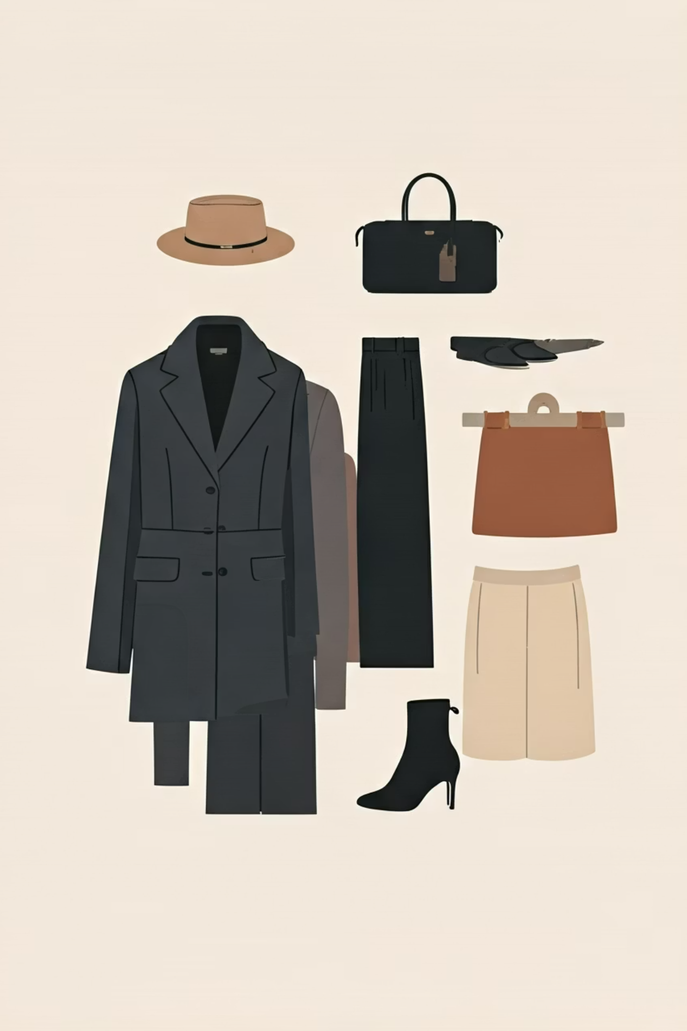
Fashion Image Classification using CNNs
Building an intelligent system to classify clothing and fashion items into 10 distinct categories using deep learning. This project leverages the Fashion-MNIST dataset and a Convolutional Neural Network built with TensorFlow and Keras, demonstrating practical image recognition for real-world fashion applications.
Arnav Gupta
Spandan Basu Chaudhuri

Slide 2
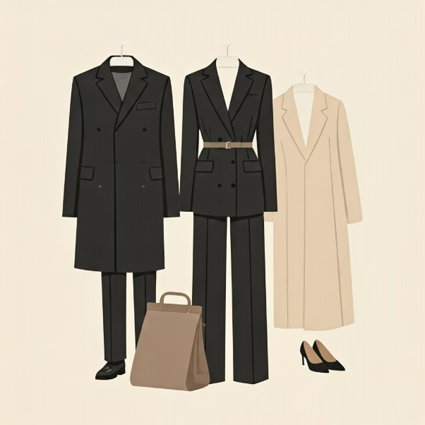

What is Fashion-MNIST?
Dataset Overview
Image Specifications
Created by Zalando Research as a modern alternative to the traditional MNIST digit dataset, Fashion-MNIST provides a more challenging and realistic benchmark for machine learning models.
Each image in the dataset is carefully standardized:
28×28 pixel resolution
Grayscale format (single channel)
The dataset contains:
Represents one of 10 clothing categories
60,000 training images for model learning
10,000 testing images for validation

Slide 3
The 10 Fashion Categories
T-shirt/Top
Trouser
Pullover
Dress
Coat
Sandal
Shirt
Sneaker
Bag
Ankle Boot
These ten distinct labels form the foundation of our classification system, allowing the model to interpret and categorize fashion items accurately. Each category represents a common clothing or accessory type found in everyday fashion retail.

Slide 4

Data Preprocessing Pipeline
01
02
Normalization
Reshape Operation
Pixel values scaled from 0–255 to 0–1 range, enabling faster convergence and stable gradient descent during training.
Image dimensions transformed from (28, 28) to (28, 28, 1) to explicitly include the channel dimension required by CNN layers.
03
Optimization Ready
Preprocessed data helps the CNN learn meaningful image features more effectively, improving model performance and training efficiency.

Slide 5

Why CNNs Excel at Image Classification
Automatic Feature Detection
Convolutional Neural Networks automatically identify and learn hierarchical patterns in images without manual feature engineering:
Edges and contours in early layers
Textures and patterns in middle layers
Complex shapes in deeper layers
Superior to Fully Connected Networks
Efficient Parameter Reduction
CNNs preserve spatial relationships between pixels, making them ideal for image tasks where position and context matter.
Pooling layers reduce spatial dimensions while retaining critical information, decreasing computation and preventing overfitting.

Slide 6
CNN Model Architecture
Layer
Description
Conv2D (32 filters)
Learns low-level features like edges and curves
MaxPooling2D
Reduces spatial size while retaining key information
Conv2D (64 filters)
Learns higher-level patterns such as cloth texture
MaxPooling2D
Further feature compression and abstraction
Flatten
Converts 2D feature matrix into 1D vector
Dense (128 neurons + ReLU)
Classification learning with non-linear activation
Dropout (40%)
Prevents overfitting by randomly disabling neurons
Dense (10 + Softmax)
Output layer producing class probabilities
This architecture progressively extracts features from simple to complex, culminating in accurate classification across all 10 fashion categories.

Slide 7
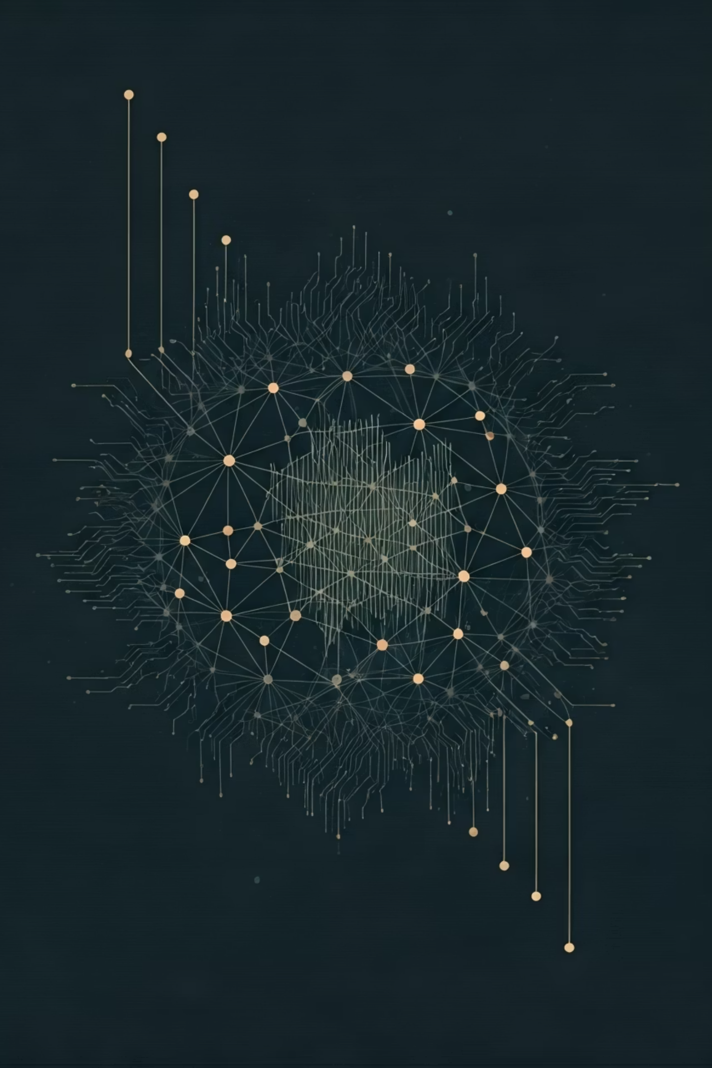



Model Compilation & Training
Adam Optimizer
Efficient adaptive learning rate algorithm that combines momentum and RMSprop for fast, stable convergence.
Loss Function
Sparse Categorical Crossentropy measures prediction error, perfect for integer class labels without one-hot encoding.
Training Process
10 epochs with validation monitoring, allowing the model to iteratively learn feature patterns and improve accuracy.
Throughout training, the model progressively refines its internal weights, learning to distinguish between different clothing categories with increasing precision.

Slide 8
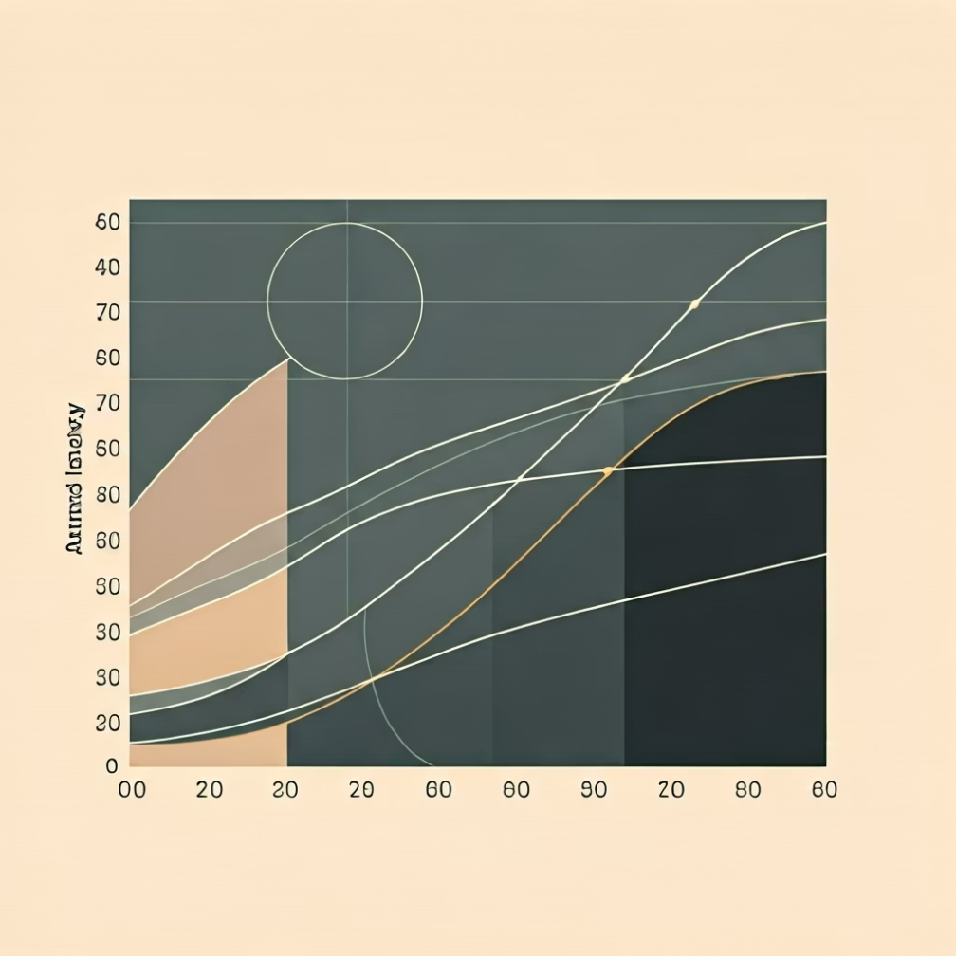

Model Performance
Strong Classification Results
The trained model achieves impressive performance on the test dataset:
90%+
Test Accuracy
Demonstrates excellent generalization to unseen fashion images
Training history reveals consistent improvement across epochs, with both accuracy increasing and loss decreasing steadily.
Key Insight: The convergence pattern indicates effective learning without overfitting, validating our architecture choices including dropout regularization.

Slide 9

Prediction Results Visualization
Correct Predictions (Green)
When the model's predicted class matches the true label, results are highlighted in green, demonstrating successful classification.
Incorrect Predictions (Red)
Misclassifications appear in red, revealing edge cases where similar items (like shirts vs. coats) may confuse the model.
This visualization approach provides immediate insight into model performance and decision-making, essential for debugging and improving the system in production environments.

Slide 10



Conclusion & Future Applications
Successfully Built a Robust CNN Classifier
CNNs Excel at Computer Vision Tasks
Our model accurately recognizes and categorizes 10 distinct clothing types, achieving over 90% test accuracy with strong generalization capabilities.
This project demonstrates the power of convolutional architectures for image recognition, validating their superiority over traditional approaches.
Real-World Extensions
Fashion Recommendation Systems
Retail Automation
E-commerce Catalog Classification
Automated inventory management and smart fitting room technology
Personalized product suggestions based on style preferences and visual similarity
Automatic product categorization and visual search capabilities

